Slide 1
Work summary

Slide 2
Anticipated contribution
1. Propose a fasttext visualization method
2. Base on the visualization results, improve fasttext model performance
Dataset:
Imdb sentiment classification
Reuters subject classification

Slide 3
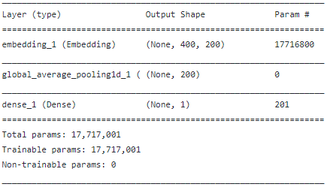
Fasttext model architecture
>0.5 positive
<0.5 negative
sigmoid
Dense
sum/4
Average pooling
i
like
this
movie
+
+
+
Embedding layer
I like this movie

Slide 4
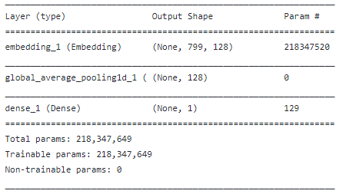
Fasttext-bigram model architecture
>0.5 positive
<0.5 negative
Dense
sigmoid
sum/7
Average pooling
i
like
this
Movie
(I like)
(like this)
(this movie)
Embedding layer
I like this movie

Slide 5
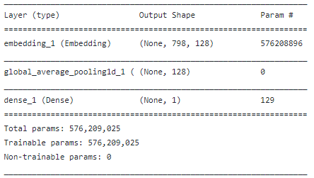
Fasttext-trgram model architecture
>0.5 positive
<0.5 negative
Dense
sigmoid
sum/6
Average pooling
i
like
this
Movie
(I like this)
(like this movie)
Embedding layer
I like this movie

Slide 6
Fasttext model visualization
Dense weight
words weight
i
like
this
movie
dot
i
like
this
movie
I like this movie
(I + like + this + movie) / 4 ☉ dense weight = I ☉ 4* dense weight + like ☉ 4* dense weight + this ☉ 4* dense weight + movie ☉ 4*dense weight

Slide 7
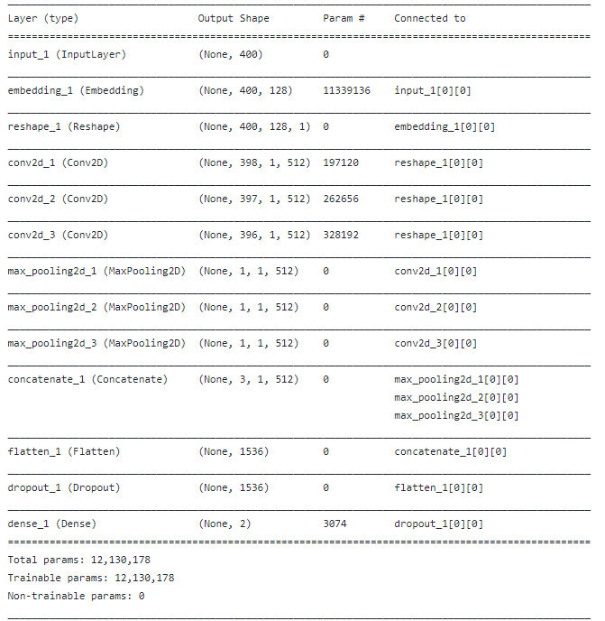
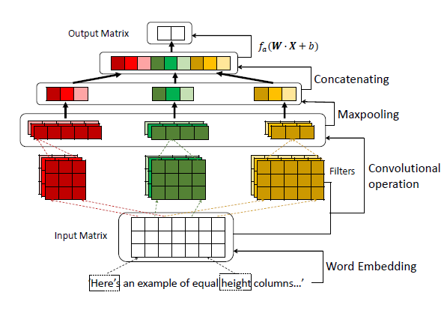
Text-CNN model(baseline) architecture
Refer: https://chunyang-chen.github.io/publication/proactiveEdit_cscw18.pdf

Slide 8
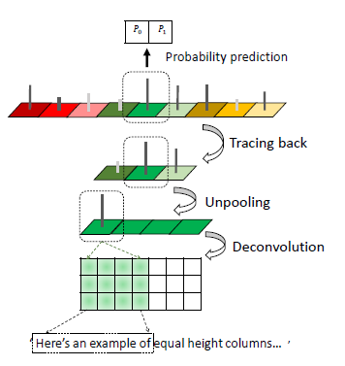
Text-CNN model(baseline) visualisation
Refer: https://chunyang-chen.github.io/publication/proactiveEdit_cscw18.pdf

Slide 9
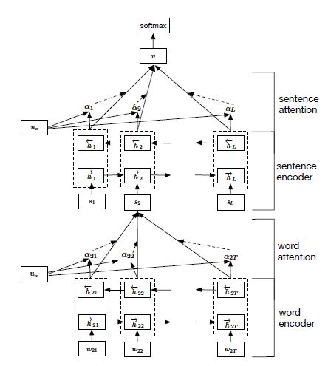
RNN(HAN)(baseline) architecture
Refer: http://www.aclweb.org/anthology/N16-1174(2016)
Visualization by attention weight

Slide 10
Next step baseline
Attention-Based LSTM
Saliency Map
Refer:
Attention-Based LSTM for Psychological Stress Detection from Spoken Language Using Distant Supervision(2018)
https://github.com/ivanmontero/visualize-saliency
https://github.com/TobiasLee/Text-Classification
https://github.com/tianrenheyi09/tf-rnn-attention-master1

Slide 11
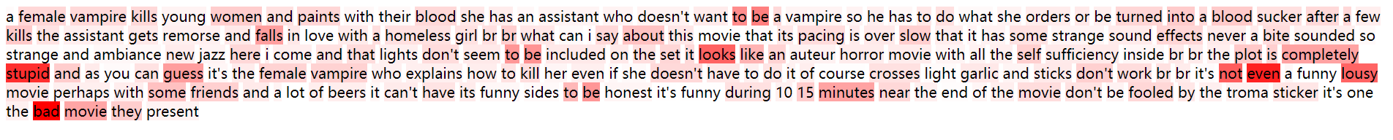
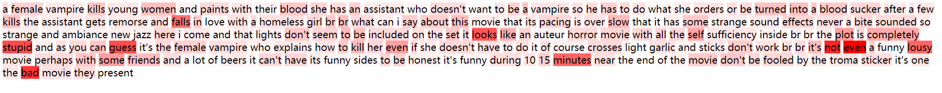
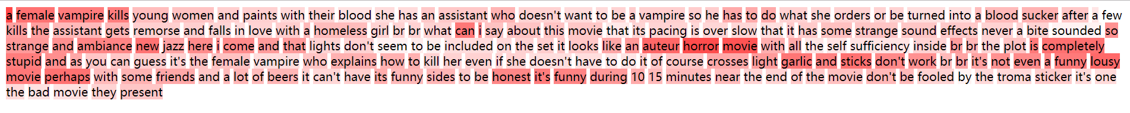
The following examples are, in turn, ft, ft-brgram, ft-trgram, cnn, rnn(han). All of them predict negative and label is negative

Slide 12
CNN predict negative and others predict positive. label is positive
Ft
ft-bigram
Ft-trgram
Cnn
rnn

Slide 13
All predict positive. label is positive
Ft
ft-bigram
Ft-trgram
Cnn
rnn

Slide 14
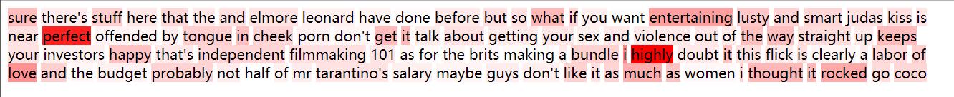
All predict positive. label is positive
Ft
ft-bigram
Ft-trgram
Cnn
rnn

Slide 15
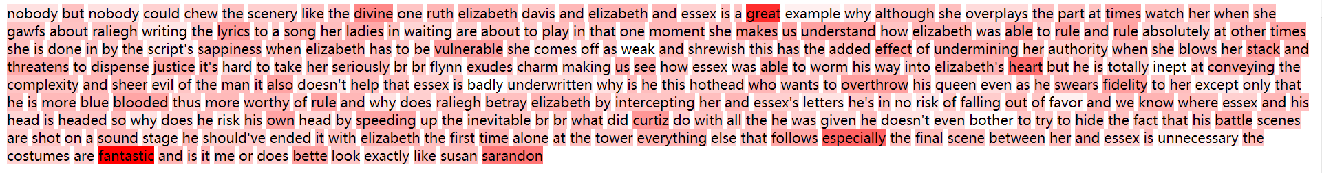
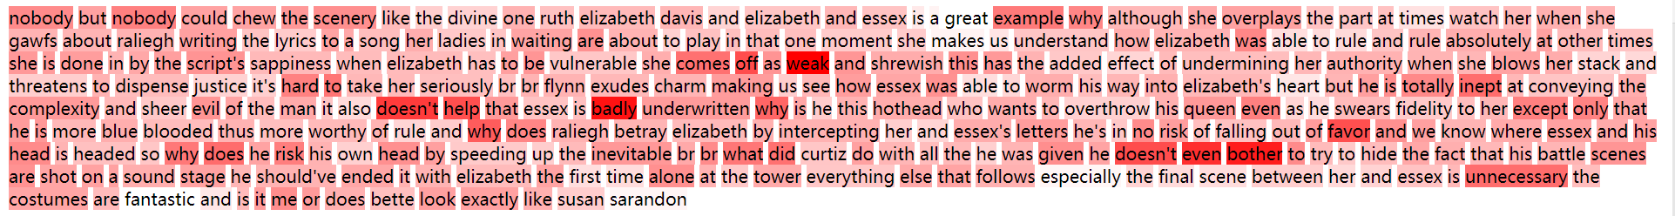
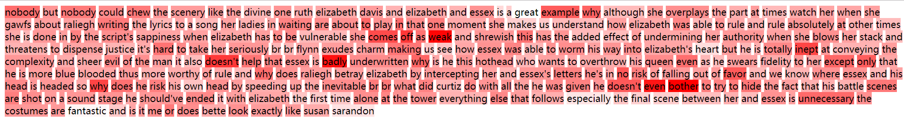
Ft, CNN predict positive. Others predict negative. label is negative

Slide 16
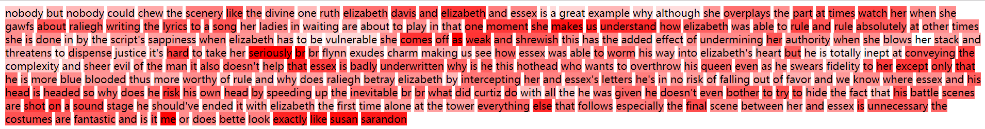
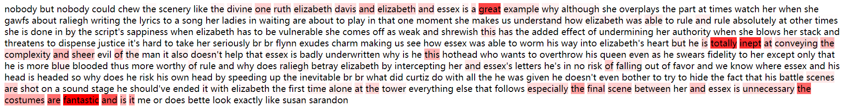
Ft, CNN predict positive. Others predict negative. label is negative

